Slide 1

Alternative & opportunity cost
Help everyone to learn faster

Slide 2

Mengevaluasi alternatif
Daftar
Membandingkan
Eliminasi
Mengulang evaluasi
Memutuskan
Help everyone to learn faster

Slide 3
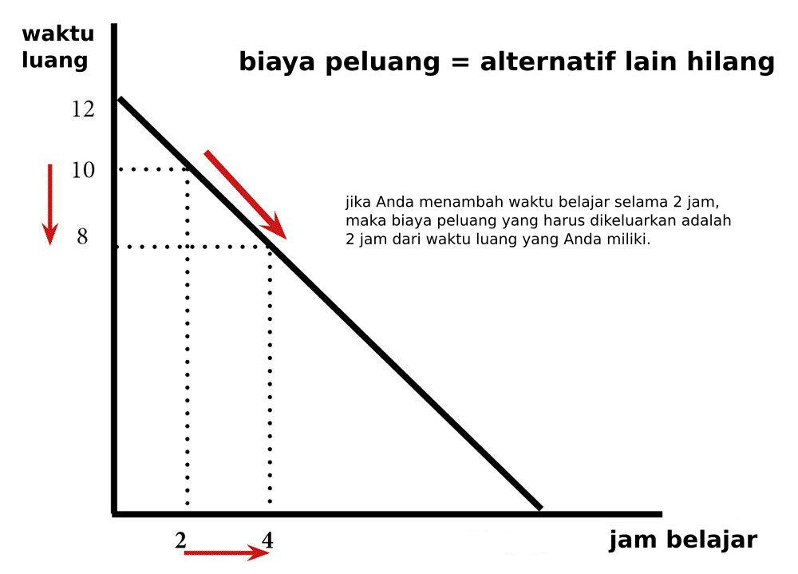
Opportunity cost
Help everyone to learn faster

Slide 4
Opportunity cost
Help everyone to learn faster

